Slide 1

An Edge-preserving Filtering Framework for Visibility Restoration
Linchao Bao, Yibing Song, Qingxiong Yang (City University of Hong Kong)
and
Narendra Ahuja (University of Illinois at Urbana-Champaign)
Notes:
Today I am going to present our work on a new edge-preserving filtering method and its application on single image dehazing. [click].

Slide 2
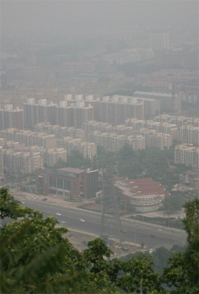
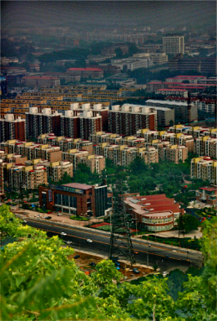
Contents
Proposed Edge-preserving
Filtering Framework
Application on Dehazing
Notes:
Specifically, first, I am going to spend most of my time on introducing our proposed filtering framework. Then, I will present its application on the single image dehazing, that is, to enhance the visibility of photos in presence of fog or haze. OK. Let’s first start from the well-known Gaussian filtering. [click].

Slide 3
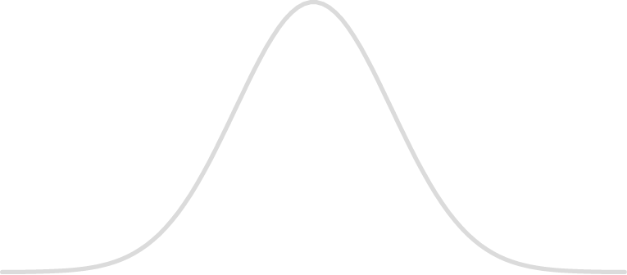
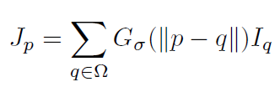
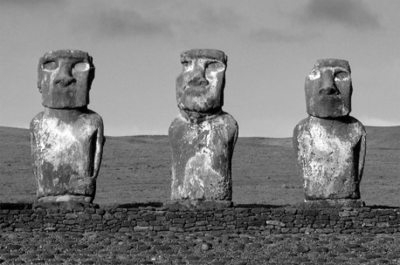

From Gaussian to Bilateral
Gaussian filtering
p, q: pixel location
Ω: the neighborhood of pixel p
G_{σ}: Gaussian function
p
q
Notes:
Gaussian filtering is to perform a convolution on an image with a Gaussian kernel. [click]. That is, given a pixel p, its filtered value is the aggregation of neighboring pixels weighted by a spatial Gaussian function. [click]. The effect of the Gaussian filtering is to simply smooth the input image. Note that the edges near large intensity jumps get blurred. This is not what we want in many applications. We say, Gaussian filter doesn’t have the edge-preserving ability.
[click].

Slide 4
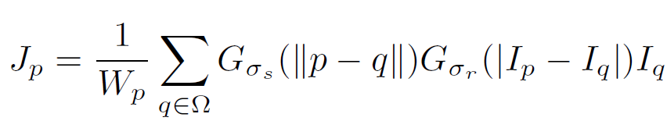

From Gaussian to Bilateral
Bilateral filtering
G_{σ_s} ,G_{σ_r} : Gaussian function
W_{p}: Weight normalization factor
p
q
[Tomasi and Manduchi ICCV’98]
Notes:
One improvement is the bilateral filter, which is to add another kernel on the intensity domain to further control the weights of neighboring pixels. Specifically, the red kernel gives higher weights to spatially close pixels, and the blue kernel gives higher weights to pixels with similar intensities. The final weight of a neighboring pixel is the multiplication of the two weights. [click]. Thus, the bilateral filter can better preserve edges with large intensity jumps. And such edge-preserving filter is very useful in many applications. [click].

Slide 5
Edge-preserving Filtering Applications
Detail enhancement [Farbman et al. 08]
HDR tone mapping [Durand and Dorsey 02]
Image abstraction/stylization [Winnemoller et al. 06]
Joint filtering (upsampling, colorization) [Kopf et al. 07]
Photo-look transferring [Bae et al. 06]
Video enhancement [Bennett and McMillan 05]
Haze removal (Dehazing) [Tarel and Hautiere 09]
Shadow Removal [Yang et al. 12]
Notes:
[click]

Slide 6
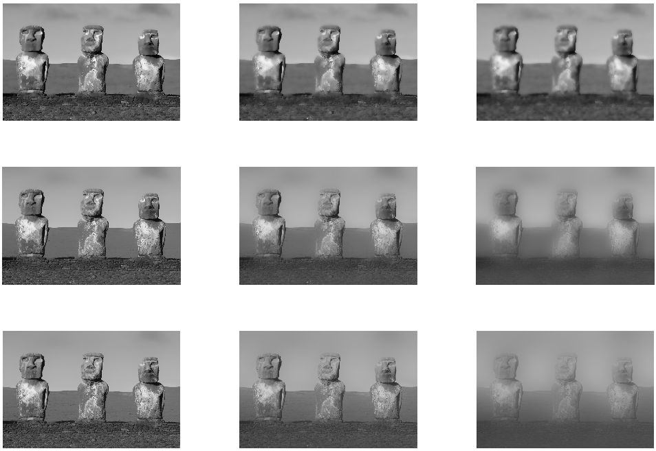
Bilateral Filtering
σ_{r}
0.1
0.2
0.4
0.01
σ_{s}
0.05
0.1
Notes:
Note that the bilateral filter has two parameters. One is to control the Gaussian function of the spatial kernel, sigma_s, and the other is to control the intensity kernel, or in another word, range kernel, sigma_r. Here is an overview of the results of tuning the parameters. [click].

Slide 7

Input image
Notes:
For another example, if we want to smooth out the noise on the constant regions using bilateral filter [click], the color version, [click], we may need to tune the parameters like this.

Slide 8
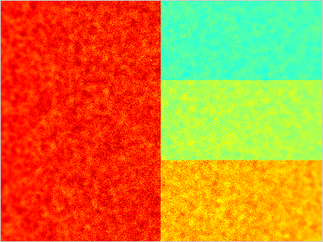
Input image (color visualized)
Notes:
For another example, if we want to smooth out the noise on the constant regions using bilateral filter [click], the color version, [click], we may need to tune the parameters like this.

Slide 9
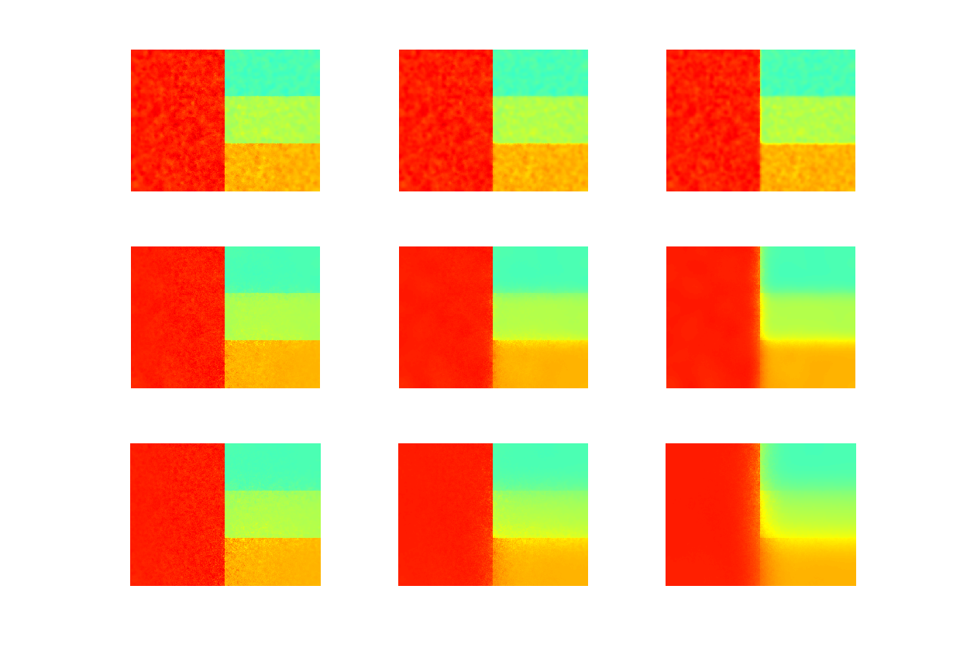
σ_{r}
0.1
0.2
0.4
σ_{s}
0.01
0.05
0.1
Notes:
Unfortunately, none of the results is what we want. Let’s see what the problem is. Regardless of sigma_s, for smaller sigma_r, the noise cannot be smoothed out, while for larger sigma_r, the edges between constant regions get blurred. For a clear view, it is like this [click].

Slide 10
Bilateral Filtering
Smaller σ_{r}
Larger σ_{r}
Edge blurred
Not smoothed
Notes:
Smaller sigma range, smoothness not enough. Larger sigma range, edge blurred. Well, our method solves this problem. For example [click].

Slide 11
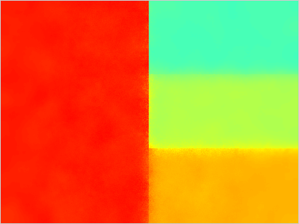
Bilateral filtered
Notes:
Original result. [click]

Slide 12

Our Filtering Framework
Our bilateral filtered
Notes:
And our result. The idea is. [click]

Slide 13
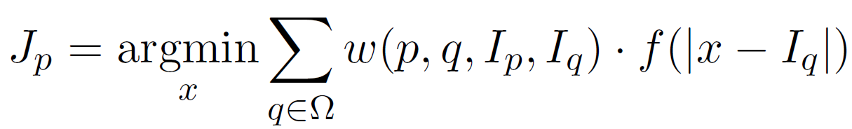
Idea
Find the optimal filtered value for each pixel, such that
Weighting function
Cost function
Ω: The neighboring pixels of p
Perform aggregations on costs of neighboring pixels w.r.t. different x values, and then select the optimal x* as the output filtered value!
Reminder: Gaussian and bilateral filter are just aggregations using different weighting functions!
Notes:
[click]. For each pixel p, we want to find the optimal pixel intensity such that the aggregation of neighboring pixels on a certain cost function is minimized. This is somewhat similar to energy minimization approach. But here we will explore it in another perspective. A reminder: [click] the weighting function can be just borrowed from Gaussian or bilateral filter. We will use this property later. Let’s first see a simple example. [click]

Slide 14
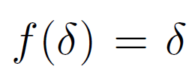
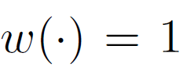
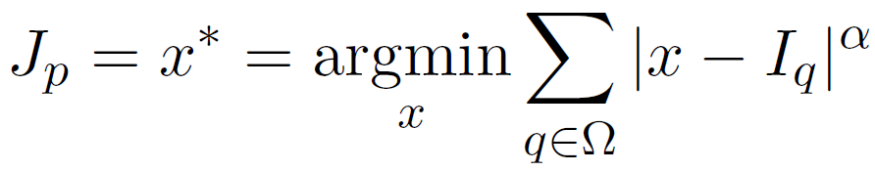
First example
Neighborhood of p
p
Where is x* ?
q
Notes:
Let the cost function be the power function, and the weighting function to be a constant. Then our framework becomes this form. That is, given a pixel p [click] and its neighboring pixels [click], we want to find the optimal x* as the output filtered value Jp. [click]

Slide 15
First example
Neighborhood of p
p
Where is x* ?
q
Notes:
[click].

Slide 16
First example
Neighborhood of p
α = 2.0
x*
q
Notes:
Let’s see. If alpha equals to two, then the objective function is in quadratic form and the optimization problem can be solved in closed-form. It turns out that the optimal value x* for p is the average of all neighboring pixels of p. [click] [click]

Slide 17
First example
Neighborhood of p
α = 2.0
α = 1.0
x*
x*
q
Notes:
If alpha equals to one, well, the problem is a little harder to solve. But you can find the answer from some mathematical books that the solution to this problem turns out to be the median (of all neighboring pixels). In this case, since the neighboring pixels with higher intensity are more than the lower ones, the median is close to the higher intensity level. [click] [click]

Slide 18
First example
Neighborhood of p
α = 2.0
α = 1.0
α = 0.5
x*
x*
x*
q
Notes:
Well, then how about alpha equals to point five? Let’s consider the curve of the power function when alpha equals to point five. [click] Intuitively, unlike the quadratic curve, it doesn’t penalize too much for large costs. So it is not likely to be somewhere in between the two intensity levels like when alpha equals to two. Actually, the result turns out to be like this. [click]. It’s more likely to be near the pixels with large population.

Slide 19
First example
α = 2.0
Box filter (Mean filter)
α = 1.0
Median filter
α = 0.5
?
Notes:
The full picture, this is when alpha equals to two. [click] Alpha equals to one. [click] Alpha equals to point five. Well, it seems that when alpha is smaller than two, the filtering is more likely to be edge-preserving. To recap, actually, when alpha equals to two, [click] the filtering is just the box filtering. And it is the median filtering when alpha equals to one. [click]. Note that median filtering is somewhat a kind of edge-preserving filter. And what’s it when alpha equals to point five. [click] I don’t know. Let’s turn back to our original formulation. [click]

Slide 20
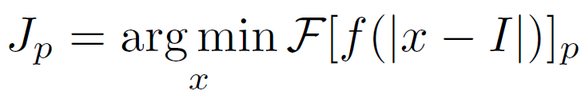
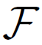
Our Framework
Find the optimal filtered value for each pixel, such that
Weighting function
Cost function
( can be any local-neighborhood-aggregation-based filter)
Notes:
As we mentioned before, the aggregation using different weighting functions can be borrowed from traditional filters such as Gaussian or bilateral filter, [click], we can simply rewrite our formulation like this. [click] The script F operator here refers to any local-neighborhood-aggregation-based filter. For now, let’s just consider a specific form of the cost function, the power function. [click]

Slide 21
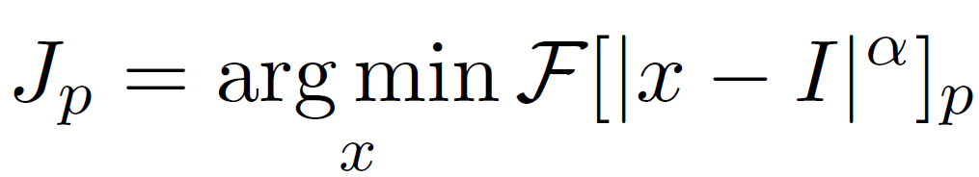
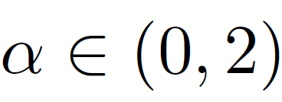

Specific Form (power cost function)
α < 2.0
Edge-preserving
can be
Box filter
Gaussian filter
Bilateral filter
Guided filter
…
α = 2.0
Original filter
Notes:
It’s like this. One most important property of using this power cost function is that, [click] when alpha is less than two, no matter what the F operator is, the filtering will be edge-preserving! [click] And of course when alpha equals to two, it is just the F operator itself. But that’s not what we are interested in. Let’s see an example. [click]

Slide 22

Examples
Gaussian filtered
Input
Notes:
Input image. [click] Gaussian filtered. [click]

Slide 23
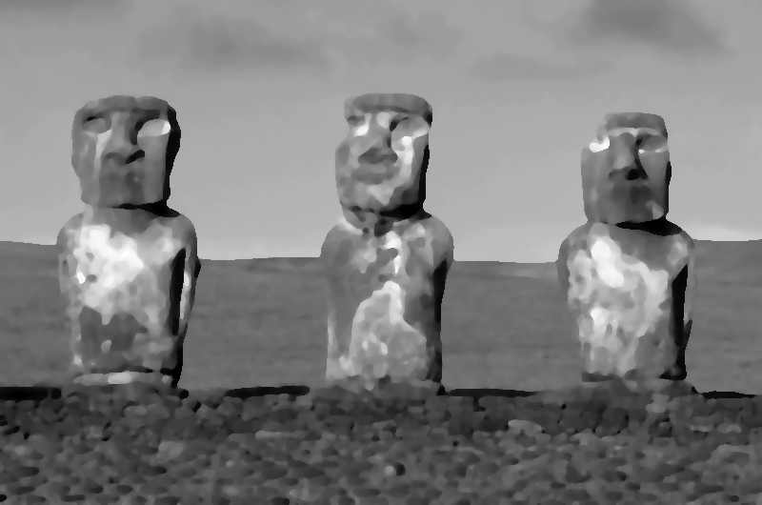
Examples
Ƒ is Gaussian filter, α = 0.5
Input
Notes:
And the Gaussian filtered result using our framework when alpha equals to point five. [click]

Slide 24

Examples
Bilateral filtered
Input
Notes:
Bilateral filtered result. [click]

Slide 25

Examples
Ƒ is bilateral filter, α = 0.5
Input
Notes:
And the Bilateral filtered result using our framework when alpha equals to point five. [click]

Slide 26
Examples
Ƒ is bilateral filter, α = 0.5
Original bilateral filter
Notes:
A comparison of the result. [click]

Slide 27
Edge-preserving Filtering Applications
Detail enhancement [Farbman et al. 08]
HDR tone mapping [Durand and Dorsey 02]
Image abstraction/stylization [Winnemoller et al. 06]
Joint filtering (upsampling, colorization) [Kopf et al. 07]
Photo-look transferring [Bae et al. 06]
Video enhancement [Bennett and McMillan 05]
Haze removal (Dehazing) [Tarel and Hautiere 09]
Shadow Removal [Yang et al. 12]
Notes:
OK, next let’s see how to apply it on dehazing application. [click]

Slide 28
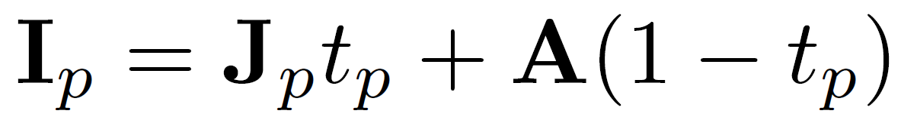
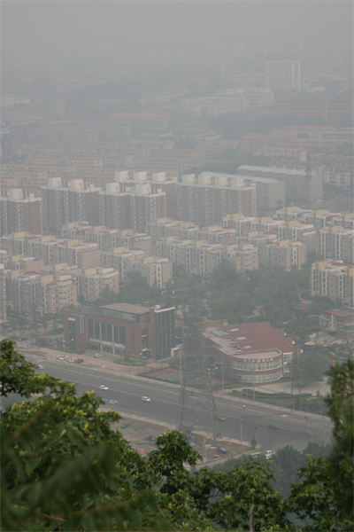

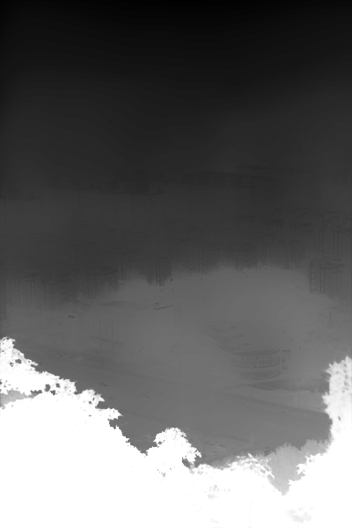
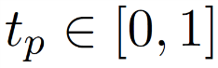
Haze Removal (Dehazing)
The widely adopted model [Narasimhan and Nayar 02]
Atmospheric light (global constant)
Haze image
(input)
Dehazed image
(desired result)
Transmission map
(haze attenuation)
Notes:
The widely used model for the formation of haze image is like this: [click] the haze image, is the actual scene image without haze [click] attenuated by haze [click] and shifted by the color of atmospheric light [click]. The problem of single image dehazing is thus to restore the actual scene image J given only the haze image I. [click]

Slide 29
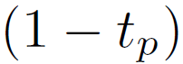
Haze Removal (Dehazing)
The widely adopted model [Narasimhan and Nayar 02]
First estimate A and transmission map t
Ill-posed – additional assumption/prior needed
Dark channel prior [He et al. 09] => Rough estimate of
Smoothness [Fattal 08] [Tan et al. 08]
White balanced input image [Tarel and Hautiere 09] => A = (1, 1, 1)
We prefer fast filtering-based method [Tarel and Hautiere 09]
Notes:
The problem is obviously ill-posed. Existing approaches for solving this problem is to first estimate the haze color A and the transmission map t by introducing some assumptions or priors. Note that the color A is a constant over all image pixels, and transmission map t is inversely proportional to the scene depth. Let’s see what are the commonly adopted assumptions and priors. First, dark channel, which is the erosion of the minimum color component of the input image, can be a rough estimate of one minus t. Second, the transmission map should be smooth except over large depth jumps. Three, the image has been white balanced thus the atmospheric light color is assumed to be full white. Also, in this paper, we prefer the filtering-based approach since it is fast. Let’s first see the filtering-based dehazing algorithm proposed by Tarel. [click]

Slide 30
Filtering-based Method [Tarel and Hautiere 09]
Haze image I
(input)
Notes:
Given an input haze image, first [click] they calculate the minimum color component W. [click] And then they perform a median filtering to get A. [click] Then perform another median filtering on the residue between A and W and then subtract it from A, get B. [click] Then the transmission map can be calculated in this way. [click] Finally, the restored result is like this.

Slide 31
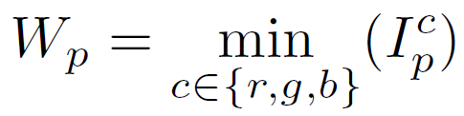
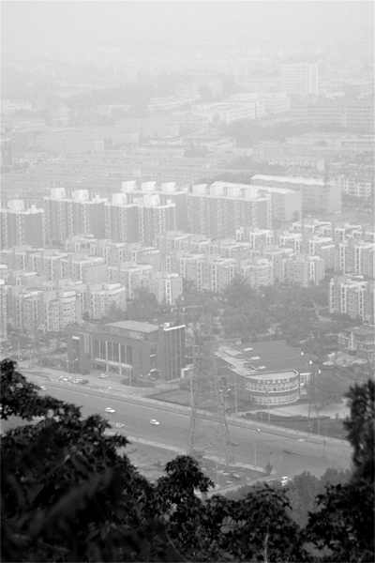
Filtering-based Method [Tarel and Hautiere 09]
1)
W
Notes:
Given an input haze image, first [click] they calculate the minimum color component W. [click] And then they perform a median filtering to get A. [click] Then perform another median filtering on the residue between A and W and then subtract it from A, get B. [click] Then the transmission map can be calculated in this way. [click] Finally, the restored result is like this.

Slide 32
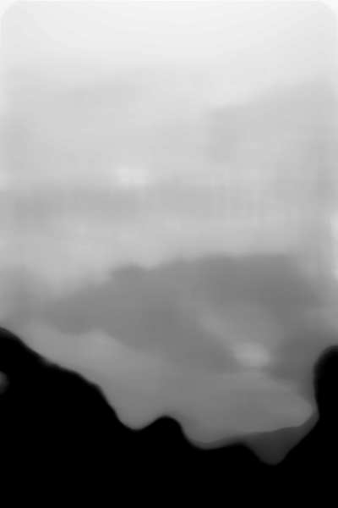
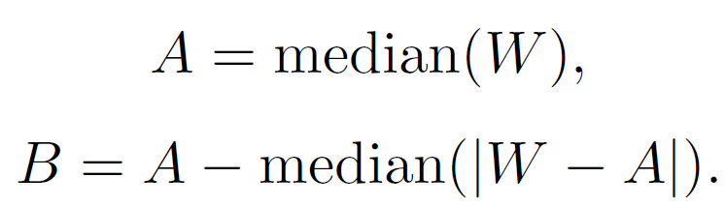
Filtering-based Method [Tarel and Hautiere 09]
1)
2)
A
Notes:
Given an input haze image, first [click] they calculate the minimum color component W. [click] And then they perform a median filtering to get A. [click] Then perform another median filtering on the residue between A and W and then subtract it from A, get B. [click] Then the transmission map can be calculated in this way. [click] Finally, the restored result is like this.

Slide 33
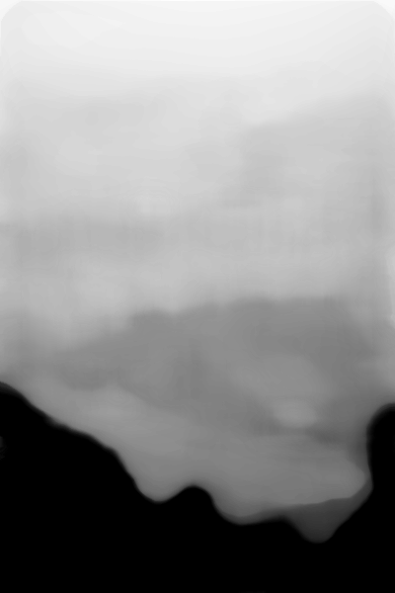
Filtering-based Method [Tarel and Hautiere 09]
1)
2)
B
Notes:
Given an input haze image, first [click] they calculate the minimum color component W. [click] And then they perform a median filtering to get A. [click] Then perform another median filtering on the residue between A and W and then subtract it from A, get B. [click] Then the transmission map can be calculated in this way. [click] Finally, the restored result is like this.

Slide 34
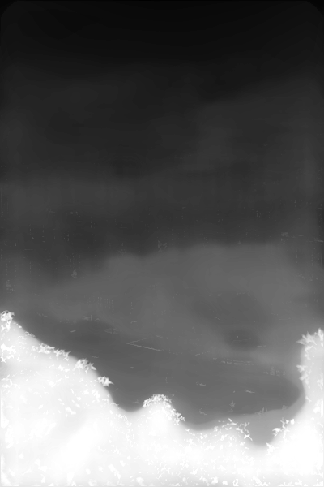
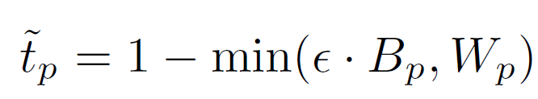
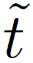
Filtering-based Method [Tarel and Hautiere 09]
1)
2)
3)
Notes:
Given an input haze image, first [click] they calculate the minimum color component W. [click] And then they perform a median filtering to get A. [click] Then perform another median filtering on the residue between A and W and then subtract it from A, get B. [click] Then the transmission map can be calculated in this way. [click] Finally, the restored result is like this.

Slide 35
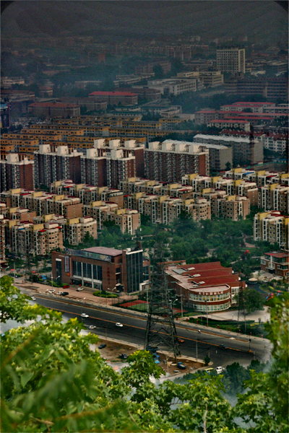
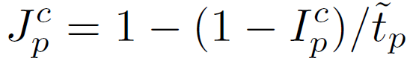
Filtering-based Method [Tarel and Hautiere 09]
1)
2)
3)
4)
J
Notes:
Let’s see what’s the problem here [click]

Slide 36
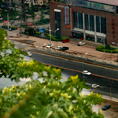
Filtering-based Method [Tarel and Hautiere 09]
1)
2)
3)
4)
Notes:
There are haze residues around scene depth jumps! The reason why it is like this is because in the filtering step, [click] they employ two median filtering to smooth the W. And the median filter will cause deviations around edge corners since the edge-preserving ability of median filter [click] is limited.

Slide 37
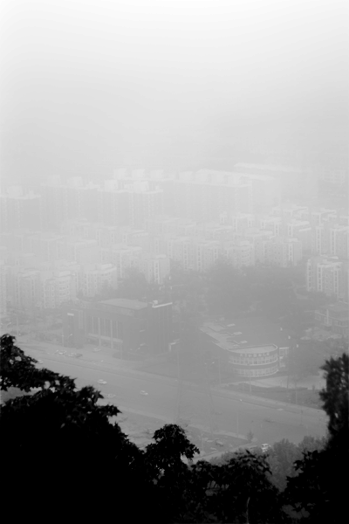
Edge-preserving Filtering
W
Median filtered
(Tarel’s method)
Bilateral filtered
Notes:
Then how about using bilateral filter? Also not satisfactory, [click] the smoothing is not enough with small sigma range. We can see the details still exist here. And the edges will also get blurred when using large sigma range parameter. That’s where our filtering method can do better. [click]

Slide 38

Edge-preserving Filtering
W
Bilateral filtered
Median filtered
(Tarel’s method)
Ours (F is BLF, α=1)
Notes:
We can see that it can achieve strong smoothing for details while the large intensity jumps get nicely preserved. Return back to the algorithm. [click]

Slide 39
Replace the filtering step
1)
2)
3)
4)
Notes:
We just replace the filtering step using our proposed filtering method and can get a result like this. [click]

Slide 40
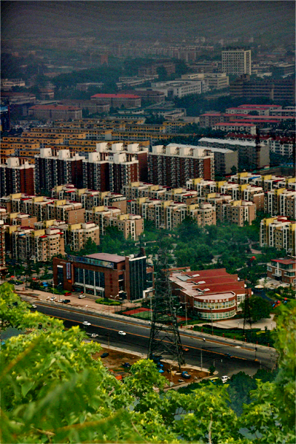
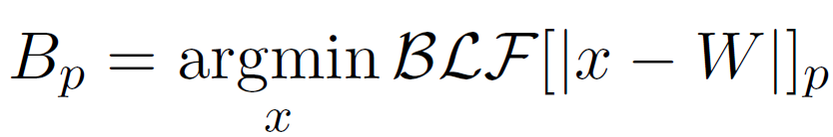
Replace the filtering step
1)
2)
3)
4)
Notes:
For a comparison, [click]

Slide 41
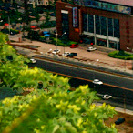
Result
Input
Tarel’s method
(0.35 sec 1-megapixel@CPU)
Our result
(0.78 sec 1-megapixel@CPU)
Notes:
[click] Note that using the fast algorithm proposed in our paper, our method can achieve a very fast speed in the same time complexity as Tarel’s method. That’s all. Thank you. [click]

Slide 42
Thank you!
Presented by Linchao Bao (@ City University of Hong Kong)

Slide 43
Implementation
Straightforward implementation:
FUNCTION J = OurFilteringFramework(I, F, α)
init output image J;
init image MinMap with maximum cost value;
FOREACH output candidate value x,
calculate intermediate image Ȋ=|x-I|^α;
obtain M by filtering Ȋ using F;
FOREACH pixel p,
if M(p)<MinMap(p) then MinMap(p)=M(p), J(p)=x;
ENDFOR
ENDFOR
ENDFUNC

Slide 44
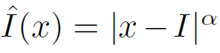
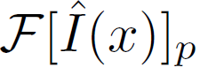
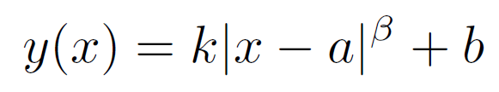
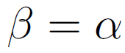
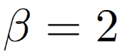
Fast Algorithm
Fast approximation algorithm: (see paper for details)
Do not filter for each candidate x value
Sampling and interpolation:
Assume local pixels are similar, then for each pixel p, filtered
follows curve , and
Filter at N sampling intensity levels, then use three x values and their costs to calculate x* using the above curve (choose three points near the bottom of the curve)
Experiments show that can usually generate good results
N>=16 can generally produce high-quality results (PSNR>40dB)

